Slide 1
Lecture 09: Interrupts & 8259

Slide 2
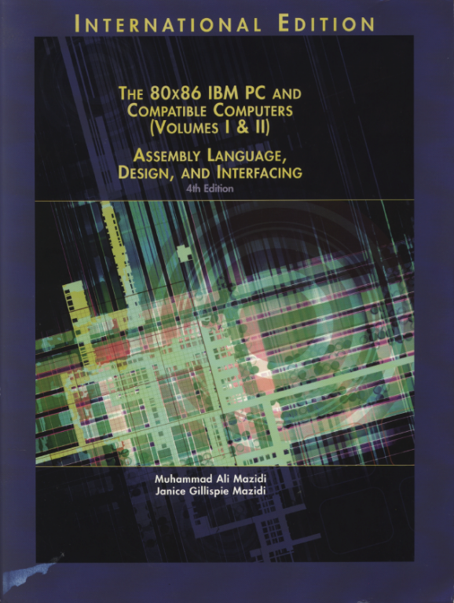
Reference Book:
The 80x86 IBM PC and Compatible Computers
Chapter 14
Interrupts and the 8259 Chip

Slide 3
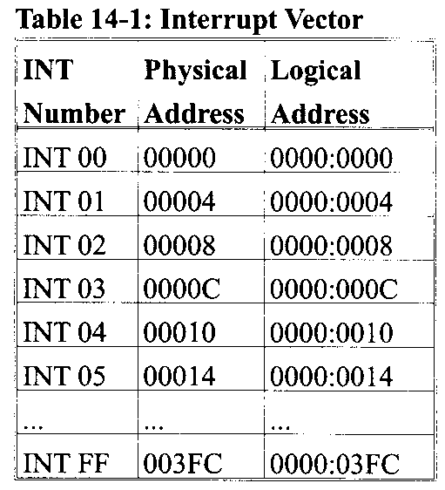
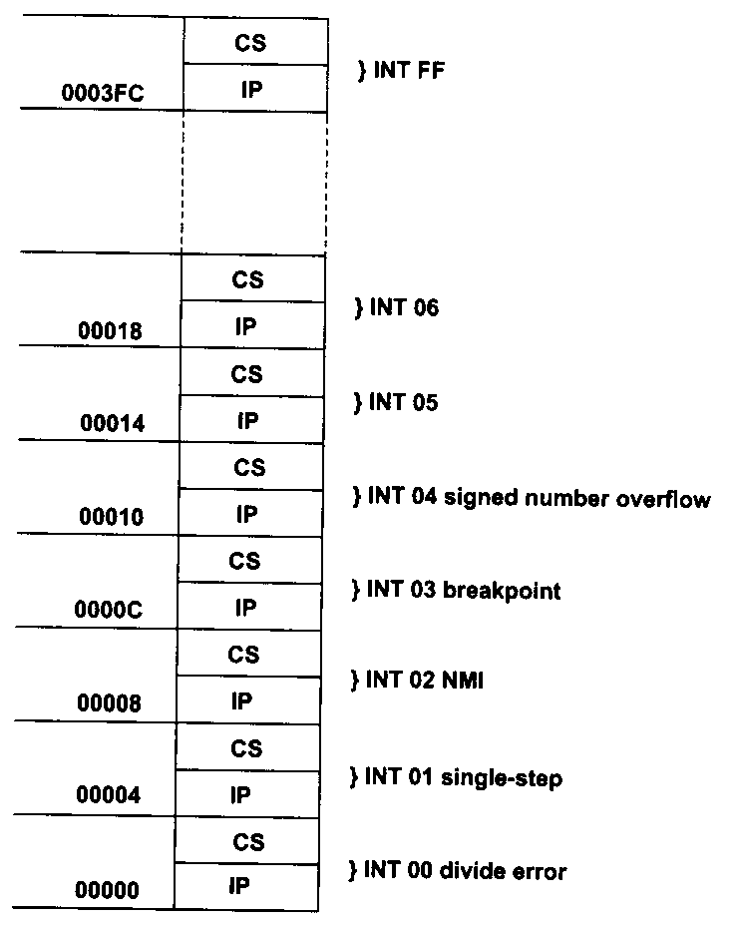
Interrupts in 8086/8088
256 interrupt types in total
INT 00 ~ INT 0FFh
Type * 4 = PA of interrupt vector
The first 1KB is used to store interrupt vectors, called Interrupt Vector Table (IVT)
Interrupt vector points the entrance address of the corresponding interrupt service routine (ISR)

Slide 4
Main Program and ISR
An ISR is launched by an interrupt event (internal ‘int xx’ or external NMI and INTR) . So ISR is ‘separated’ from main.

Slide 5
Categories of Interrupts
Hardware (external) interrupts
Maskable (from INTR)
Non-maskable (from NMI)
Software (internal) interrupts
Using the INT instruction
Predefined conditional (exception) interrupts

Slide 6
Hardware Interrupts
Non-maskable interrupt
Trigger: NMI pin, input-signal, rising edge and two-cycle high activate
TYPE: INT 02
Not affected by the IF
Reasons:
E.g., RAM parity check error, interrupt request from co-CPU 8087

Slide 7
Hardware Interrupts
Maskable interrupt
Trigger: INTR pin, input-signal, high active
TYPE: No predefined type
IF = 1, enable; IF = 0, disable
STI sets IF, CLI clears IF
Reasons:
Interrupt requests of external I/O devices

Slide 8
Procedure for Processing Maskable Interrupts
CPU responds to INTR interrupt requests
External I/O devices send interrupt requests to CPU
CPU will check INTR pin on the last cycle of an instruction: if the INTR is high and IF = 1, CPU responds to the interrupt request
CPU sends two negative pluses on the ~INTA pin to the I/O device
After receiving the second ~INTA, I/O device sends the interrupt type N on the data bus

Slide 9
Procedure for Processing Maskable Interrupts
CPU executes the ISR of INT N
CPU reads the N from data bus
Push the FR in stack
Clear IF and TF
Push the CS and IP of the next instruction in stack
Load the ISR entrance address and moves to the ISR
At the end of the ISR, IRET will pop IP, CS and FR in turn, CPU returns to previous program and proceeds

Slide 10
Software Interrupts
INT xx instruction
An ISR is called upon instruction such as “INT xx”
E.g., int 21h ; Dos service
CPU always responds and goes execute the corresponding ISR
Not affected by the IF
You can “CALL” any ISR by using the INT instruction

Slide 11
Difference between INT & CALL
CALL FAR can jump anywhere within 1MB vs. INT jumps to a fix location (finding the corresponding ISR)
CALL FAR is in the sequence of instructions vs. an external interrupt can come in at any time
CALL FAR cannot be masked (disabled) vs. an external interrupt can be masked
CALL FAR saves CS:IP of next instruction vs. INT saves FR + CS:IP of next instruction
last instruction: RETF vs. IRET

Slide 12
Software Interrupts
Predefined conditional interrupts
“INT 00” (divide error)
Reason: dividing a number by zero, or quotient is too large
“INT 01” (single step)
If TF = 1, CPU will generates an INT 1 interrupt after executing each instruction for debugging
“INT 03” (breakpoint)
When CPU hits the breakpoint set in the program, CPU generates INT 3 interrupt for debugging
“INT 04” (signed number overflow)
INTO instruction
Check the OF after an arithmetic instruction
;How to clear TF?
PUSHF
POP AX
AND AX 0FEFFH
PUSH AX
POPF
MOV AX,0009H
ADD AX,0080H
INTO

Slide 13
Procedure for Processing Non-Maskable & Software Interrupts
For NMI
CPU checks NMI, generates INT 02 interrupt automatically regardless of IF and executes to the ISR
For software (internal) interrupts
CPU generates INT N interrupt automatically and executes to the corresponding ISR

Slide 14
Interrupt Vector Table of 8086/8088
256 interrupts
❖ 0～4 dedicated
❖ 5～31reserved for system use
□ 08H～0FH：8259A
□ 10H～1FH：BIOS
❖ 32～255 reserved for users
□ 20H～3FH：DOS
□ 40H～FFH：open
For users,
224 interrupts
For system,
27 interrupts
5 dedicated interrupts

Slide 15
Interrupt Priority
INT instruction has higher priority than INTR and NMI
NMI has higher priority than INTR
For different external interrupt requests, different strategies can be used to determine their priorities.

Slide 16
Priority of INTR Interrupts
Software polling
The sequence of checking determines the priority

Slide 17
Priority of INTR Interrupts
Hardware checking
The location in the daisy chain counts

Slide 18
Priority of INTR Interrupts
Vectored interrupt controller
E.g., 8259

Slide 19
8259
8259 is Programmable Interrupt Controller (PIC)
It is a tool for managing the interrupt requests.
8259 is a very flexible peripheral controller chip:
PIC can deal with up to 64 interrupt inputs
interrupts can be masked
various priority schemes can also programmed.
originally (in PC XT) it is available as a separate IC
Later the functionality of (two PICs) is in the motherboards chipset.
In some of the modern processors, the functionality of the PIC is built in.

Slide 20
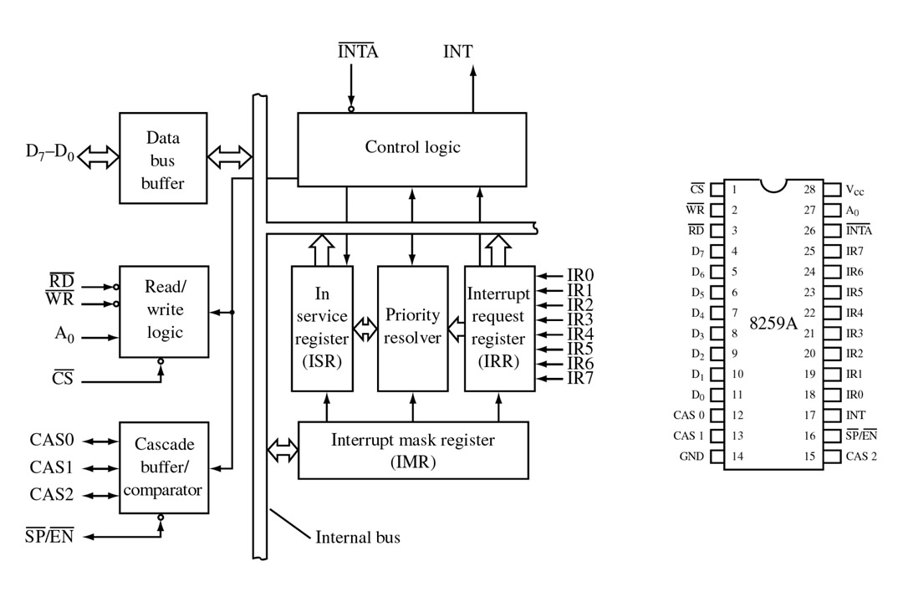
FIGURE 1 Block diagram and pin definitions for the 8259A Programmable Interrupt Controller (PIC). (Courtesy of Intel Corporation.)

Slide 21
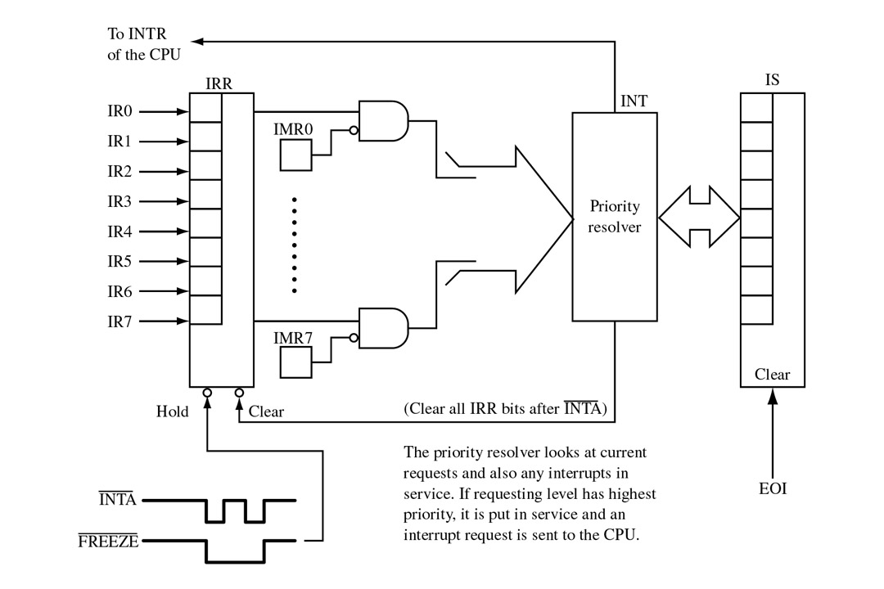
FIGURE 2 All interrupt requests must pass through the PIC’s interrupt request register (IRR) and interrupt mask register (IMR). If put in service, the appropriate bit of the in-service (IS) register is set.

Slide 22
Interrupt Nesting
Higher priority interrupts can interrupt lower interrupts
Main Program
IR2 and IR4 INTR
IR2 ISR
IR1 INTR
IR1 ISR
:
:
:
:
STI
:
(EOI)
:
IRET
STI
:
:
(EOI)
IRET
Set IF = 1
Allow lower priority interrupts
Allow lower priority interrupts in 8259
IR4 ISR
IR3 ISR
IR3 INTR
:
STI
:
:
(EOI)
IRET
:
STI
:
(EOI)
IRET
IF = 1
Allow lower priority interrupts
Allow lower priority interrupts

Slide 23
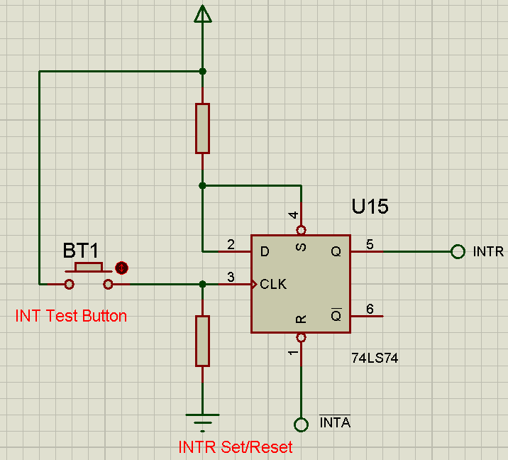
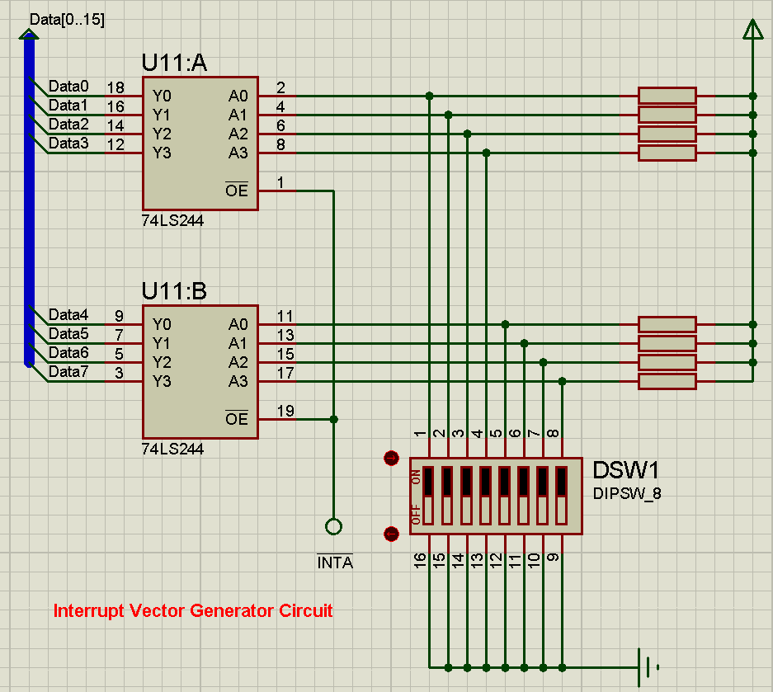
Exp. 3: Interrupts

